Slide 1
Heuristic Search

Slide 2
Outline
Generate-and-test
Hill climbing
Best-first search
Problem reduction
Constraint satisfaction
Means-ends analysis

Slide 3
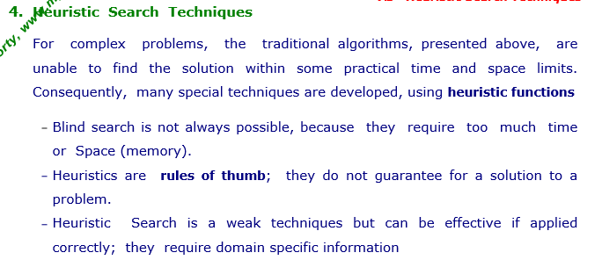

Slide 4
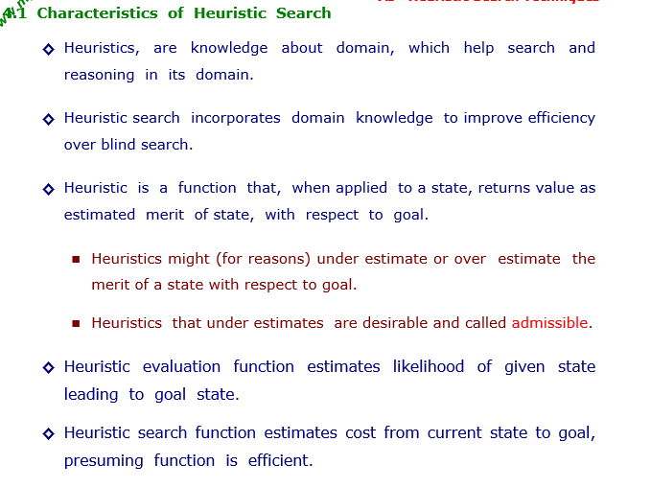

Slide 5
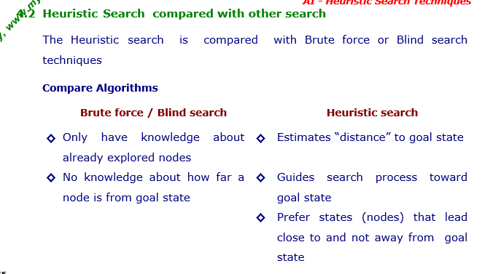

Slide 6
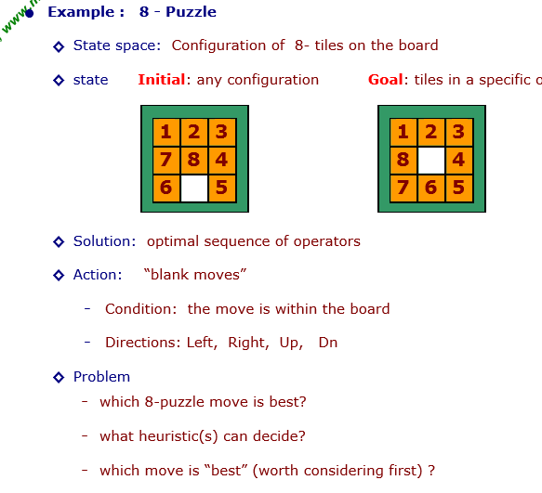

Slide 7
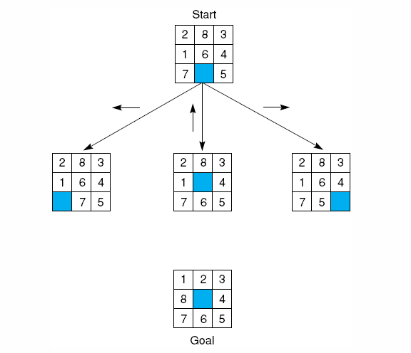
An example-8 puzzle.
Notes:
Insert fig 4.12

Slide 8
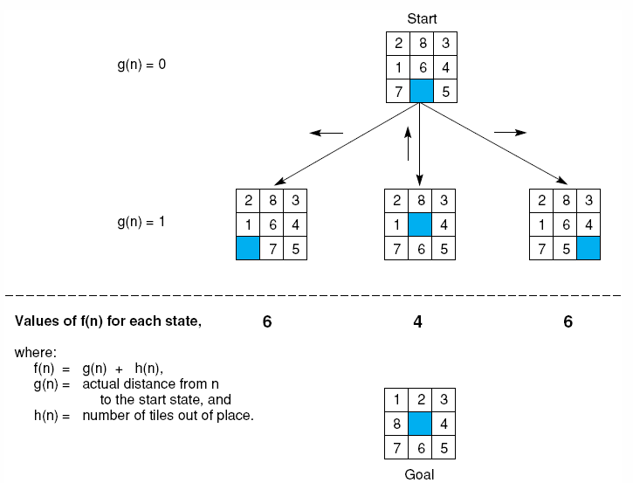
Notes:
Insert fig 4.15

Slide 9
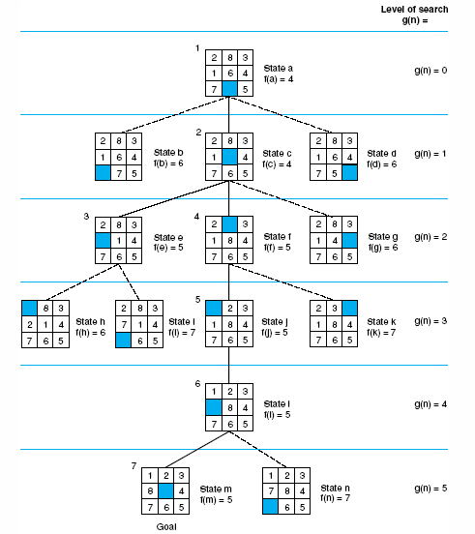
Notes:
Insert fig 4.16

Slide 10
Generate-and-Test
Algorithm
Generate a possible solution.
Test to see if this is actually a solution.
Quit if a solution has been found.
Otherwise, return to step 1.

Slide 11
Generate-and-Test
Acceptable for simple problems.
Inefficient for problems with large space.

Slide 12
Generate-and-Test
Exhaustive generate-and-test.
Heuristic generate-and-test: not consider paths that seem unlikely to lead to a solution.
Plan generate-test:
− Create a list of candidates.
− Apply generate-and-test to that list.

Slide 13
Generate-and-Test
Example: coloured blocks
“Arrange four 6-sided cubes in a row, with each side of
each cube painted one of four colours, such that on all four
sides of the row one block face of each colour is showing.”

Slide 14
Generate-and-Test
Example: coloured blocks
Heuristic: if there are more red faces than other colours
then, when placing a block with several red faces, use few
of them as possible as outside faces.

Slide 15
Hill Climbing
Generate-and-test + direction to move.
Heuristic function to estimate how close a given state is to a goal state.

Slide 16
Simple Hill Climbing
Algorithm
Evaluate the initial state.
Loop until a solution is found or there are no new operators left to be applied:
− Select and apply a new operator
− Evaluate the new state:
goal → quit
better than current state → new current state

Slide 17
Steepest-Ascent Hill Climbing (Gradient Search)
Considers all the moves from the current state.
Selects the best one as the next state.

Slide 18
Steepest-Ascent Hill Climbing (Gradient Search)
Algorithm
Evaluate the initial state.
Loop until a solution is found or a complete iteration produces no change to current state:
− SUCC = a state such that any possible successor of the
current state will be better than SUCC.
− For each operator that applies to the current state, evaluate
the new state:
goal → quit
better than SUCC → set SUCC to this state
− SUCC is better than the current state → set the current
state to SUCC.

Slide 19
Hill Climbing: Disadvantages
Local maximum
A state that is better than all of its neighbours, but not
better than some other states far away.

Slide 20
Hill Climbing: Disadvantages
Plateau
A flat area of the search space in which all neighbouring
states have the same value.

Slide 21
Hill Climbing: Disadvantages
Ridge
The orientation of the high region, compared to the set
of available moves, makes it impossible to climb up.
However, two moves executed serially may increase
the height.

Slide 22
Hill Climbing: Disadvantages
Ways Out
Backtrack to some earlier node and try going in a different direction.
Make a big jump to try to get in a new section.
Moving in several directions at once.

Slide 23
Hill Climbing: Disadvantages
Hill climbing is a local method:
Decides what to do next by looking only at the “immediate” consequences of its choices.
Global information might be encoded in heuristic functions.

Slide 24
Hill Climbing: Disadvantages
Start
A
Goal
D
0
4
D
C
C
B
B
A
Blocks World
Local heuristic:
+1 for each block that is resting on the thing it is supposed to be resting on.
−1 for each block that is resting on a wrong thing.

Slide 25
Hill Climbing: Disadvantages
0
A
2
D
D
C
C
B
B
A

Slide 26
Hill Climbing: Disadvantages
D
2
C
B
A
A
0
0
D
C
C
D
C
0
B
B
A
B
A
D

Slide 27
Hill Climbing: Disadvantages
Start
A
Goal
D
−6
6
D
C
C
B
B
A
Blocks World
Global heuristic:
For each block that has the correct support structure: +1 to every block in the support structure.
For each block that has a wrong support structure: −1 to
every block in the support structure.

Slide 28
Hill Climbing: Disadvantages
D
−3
C
B
A
A
−6
−2
D
C
C
D
C
−1
B
B
A
B
A
D

Slide 29
Hill Climbing: Conclusion
Can be very inefficient in a large, rough problem space. Global heuristic may have to pay for computational complexity.
Often useful when combined with other methods, getting it started right in the right general neighbourhood.

Slide 30
Simulated Annealing
A variation of hill climbing in which, at the beginning of the process, some downhill moves may be made.
To do enough exploration of the whole space early on, so that the final solution is relatively insensitive to the starting state.
Lowering the chances of getting caught at a local maximum, or plateau, or a ridge.

Slide 31
Simulated Annealing
Physical Annealing
Physical substances are melted and then gradually cooled until some solid state is reached.
The goal is to produce a minimal-energy state.
Annealing schedule: if the temperature is lowered sufficiently slowly, then the goal will be attained.
Nevertheless, there is some probability for a transition to a higher energy state: e^{−ΔE/kT}.

Slide 32
Simulated Annealing
Algorithm
Evaluate the initial state.
Loop until a solution is found or there are no new operators left to be applied:
− Set T according to an annealing schedule
− Selects and applies a new operator
− Evaluate the new state:
goal → quit
ΔE = Val(current state) − Val(new state)
ΔE < 0 → new current state
else → new current state with probability e^{−ΔE/kT}.

Slide 33
Best-First Search
In BFS and DFS, when we are at a node, we can consider any of the adjacent as next node. So both BFS and DFS blindly explore paths without considering any cost function. The idea of Best First Search is to use an evaluation function to decide which adjacent is most promising and then explore. Best First Search falls under the category of Heuristic Search or Informed Search.
Depth-first search: not all competing branches having to be expanded.
Breadth-first search: not getting trapped on dead-end paths.
⇒ Combining the two is to follow a single path at a time, but switch paths whenever some competing path look more promising than the current one.

Slide 34
Best-First Search
OPEN: nodes that have been generated, but have not examined.
This is actually a priority queue.
CLOSED: nodes that have already been examined.
Whenever a new node is generated, check whether it has been generated before.

Slide 35
Best-First Search
OL: D B C
B E C F
E C H F G
J I C H F G
CL: A
A D
A D B E J
A
A
A
B
C
D
B
C
D
3
5
1
3
5
E
F
4
6
A
A
B
C
D
B
C
D
5
5
G
H
E
F
G
H
E
F
6
5
4
6
6
5
6
I
J
2
1

Slide 36
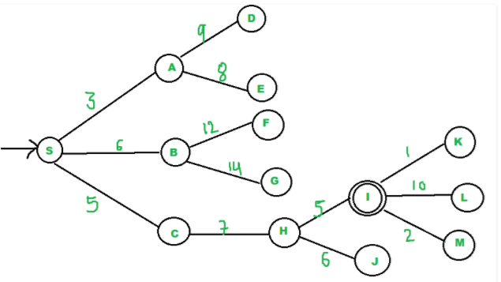
{A, C, B}
{C, B, E, D}
{B, H, E, D}
{H, E, D, F, G}
"I" is a neighbor of H, we return.

Slide 37
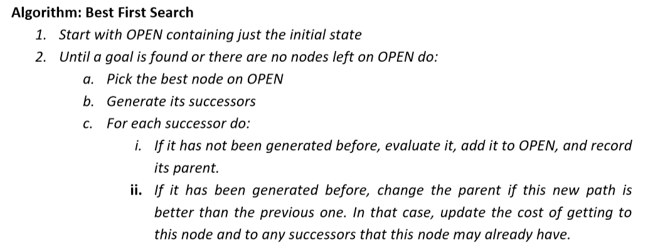
Best-First Search
Algorithm
OPEN = {initial state}.
Loop until a goal is found or there are no nodes left in OPEN:
− Pick the best node in OPEN
− Generate its successors
− For each successor:
new → evaluate it, add it to OPEN, record its parent
generated before → change parent, update successors

Slide 38
Best-First Search
Greedy search:
h(n) = estimated cost of the cheapest path from node n to a goal state.
Neither optimal nor complete
Uniform-cost search:
g(n) = cost of the cheapest path from the initial state to node n.
Optimal and complete, but very inefficient.

Slide 39
Analysis
The worst case time complexity for Best First Search is O(n * Log n) where n is number of nodes. In worst case, we may have to visit all nodes before we reach goal. Note that priority queue is implemented using Min(or Max) Heap, and insert and remove operations take O(log n) time.
Performance of the algorithm depends on how well the cost or evaluation function is designed.

Slide 40
Best-First Search
Algorithm A* (Hart et al., 1968):
f(n) = g(n) + h(n)
g(n) = cost of the cheapest path from the initial state to node n.
h(n) = cost of the cheapest path from node n to a goal state.

Slide 41
Best-First Search: A*
Algorithm A*:
f*(n) = g*(n) + h*(n)
h*(n) (heuristic factor) = estimate of h(n).
g*(n) (depth factor) = approximation of g(n) found by A* so far.

Slide 42
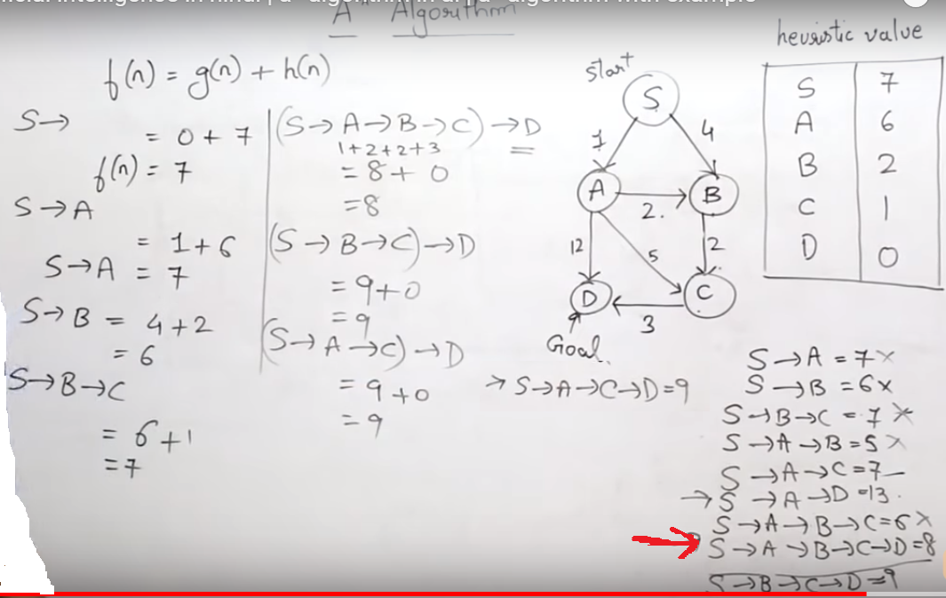

Slide 43
Best-First Search: A*
Create a search graph G, consisting solely the start node n₀.
Put n₀ on the list OPEN.
2. Set the list CLOSED = ∅.
3. If OPEN = ∅, then exit with failure.
4. Select the first node n in OPEN, remove it from OPEN, and put it on CLOSED.
5. If n is a goal node, then exit successfully with the solution obtained by tracing a path along the pointers from n to n₀.
6. Expand node n, generating the set M of its successors that are not already ancestors of n in G.

Slide 44
Best-First Search: A*
7. For each node m in M:
Not already on either OPEN or CLOSED → Add m to OPEN. Establish a pointer from m to n.
Already on either OPEN or CLOSED → Redirect its pointer to n if the best path to m found so far is through n.
8. Reorder the list OPEN in order of increasing f* values.
9. Go to step 3.

Slide 45
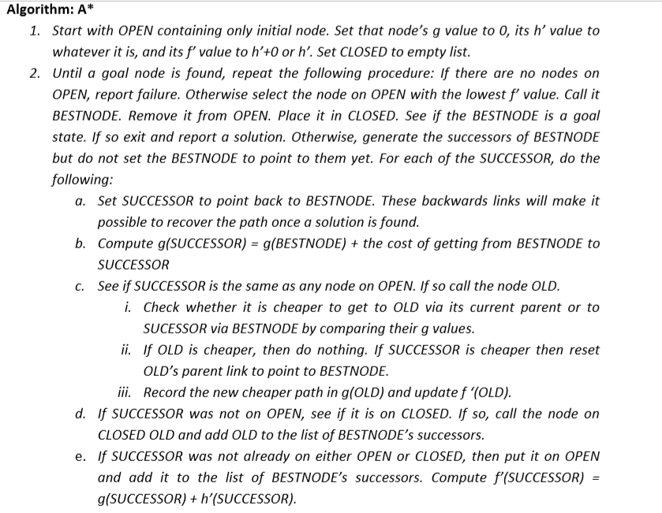

Slide 46
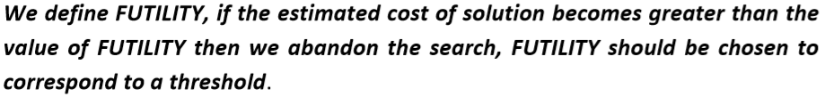
Problem Reduction
Goal: Acquire TV set
Goal: Steal TV set
Goal: Earn some money
Goal: Buy TV set
AND-OR Graphs
Algorithm AO* (Martelli & Montanari 1973, Nilsson 1980)

Slide 47
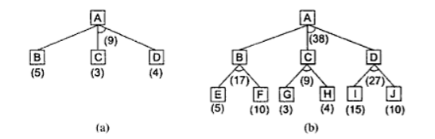

Slide 48
Problem Reduction: AO*
A
A
6
5
9
B
C
D
3
4
5
A
9
A
11
9
12
B
C
D
10
B
6
C
D
10
3
4
4
E
F
G
H
E
F
4
4
5
7
4
4

Slide 49
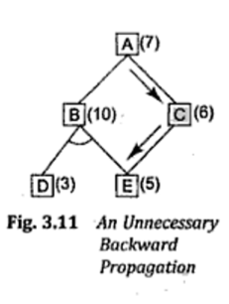
Problem Reduction: AO*
A
11
A
14
B
13
C
10
B
13
C
15
D
5
E
6
F
3
D
5
E
6
F
3
G
5
G
10
Necessary backward propagation
H
9

Slide 50
Constraint Satisfaction
Many AI problems can be viewed as problems of constraint satisfaction.
Cryptarithmetic puzzle:
SEND
MORE
MONEY
+

Slide 51
Constraint Satisfaction
As compared with a straightforard search procedure, viewing a problem as one of constraint satisfaction can reduce substantially the amount of search.

Slide 52
Constraint Satisfaction
Operates in a space of constraint sets.
Initial state contains the original constraints given in the problem.
A goal state is any state that has been constrained “enough”.

Slide 53
Constraint Satisfaction
Two-step process:
1. Constraints are discovered and propagated as far as possible.
2. If there is still not a solution, then search begins, adding new constraints.

Slide 54
Initial state:
No two letters have
the same value.
The sum of the digits
must be as shown.
M = 1
S = 8 or 9
O = 0
N = E + 1
C2 = 1
N + R > 8
E ≠ 9
SEND
MORE
MONEY
+
E = 2
N = 3
R = 8 or 9
2 + D = Y or 2 + D = 10 + Y
C1 = 0
C1 = 1
2 + D = Y
N + R = 10 + E
R = 9
S =8
2 + D = 10 + Y
D = 8 + Y
D = 8 or 9
D = 8
D = 9
Y = 0
Y = 1

Slide 55
Constraint Satisfaction
Two kinds of rules:
1. Rules that define valid constraint propagation.
2. Rules that suggest guesses when necessary.

